Slide 1
Linear Regression in Machine Learning

Slide 2
Linear Regression
Regression
When and why do you use Regression
Linear Regression
Simple Linear Regression

Slide 3
Regression
Regression is a method of modeling a target value based on independent predictors.
Regression is a technique for investigating the relationship between independent variables or features and a dependent variable or outcome.
This method is mostly used for forecasting and finding out cause and effect relationships between variables.
It aims to model the relationship between a certain number of features and a continuous target variable.

Slide 4


Regression
A regression makes it possible to infer or predict a variable on the basis of one or more other variables.
Example
Dependent Variables (criterion)
Independent Variables (Predictors)
Earnings

Slide 5
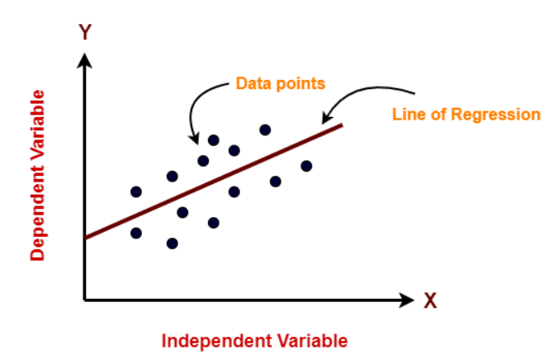
Linear Regression
Linear Regression is an ML algorithm used for supervised learning.
Linear regression performs the task to predict a dependent variable(target) based on the given independent variable(s).
The sloped straight line representing the linear relationship that fits the given data best is called a regression line.
It is also called the best fit line.

Slide 6
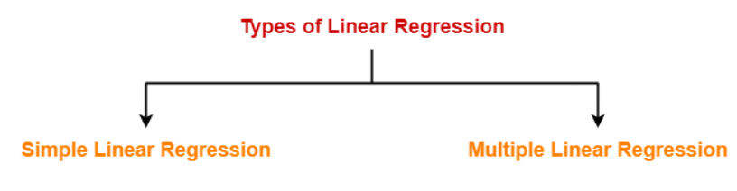
Types of Linear Regression
Based on the number of independent variables, there are two types of linear regression.
Logistic Regression

Slide 7

Simple linear regression
Simple linear regression is used to estimate the relationship between two quantitative variables.
How strong the relationship is between two variables.
The value of the dependent variable at a certain value of the independent variable.

Slide 8

Simple linear regression
Simple linear regression is used to estimate the relationship between two quantitative variables.
How strong the relationship is between two variables.
The value of the dependent variable at a certain value of the independent variable.

Slide 9

Simple linear regression
Simple linear regression is used to estimate the relationship between two quantitative variables.
How strong the relationship is between two variables.
The value of the dependent variable at a certain value of the independent variable.

Slide 10
Multiple Linear Regression
Multiple linear regression attempts to model the relationship between two or more explanatory variables and a response variable by fitting a linear equation to observed data.
Earnings

Slide 11
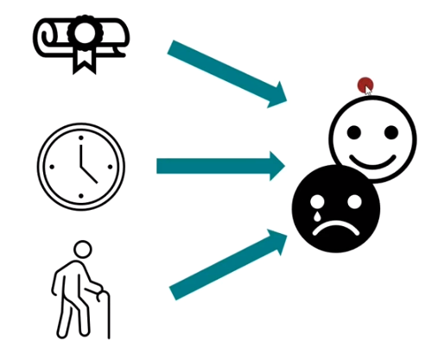
Logistic Regression
Logistic Regression is used to predict the categorical dependent variable using a given set of independent variables.

Slide 12
Forms of Regression Analysis
Examples:
Simple Linear Regression
Does the weekly working time have an influence on the hourly wage of employees.
Multiple Linear Regression
Does the weekly working time and the age of the employees have an influence on the hourly wage.
Logistic Regression
Does the weekly working time and the age of employees have an influence on the probability that they are at risk of burnout?
Independent Variable
Dependent wage
Linear Regression is used to handle regression problems whereas Logistic regression is used to handle classification problems.

Slide 13
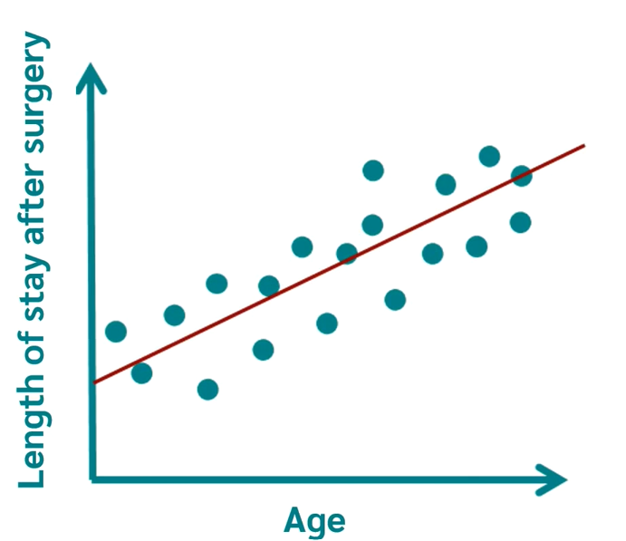
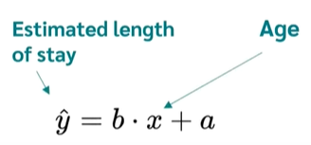
Simple Linear Regression
A general form or Standard Form Straight Line: y = mx + c
Slope
intercept

Slide 14
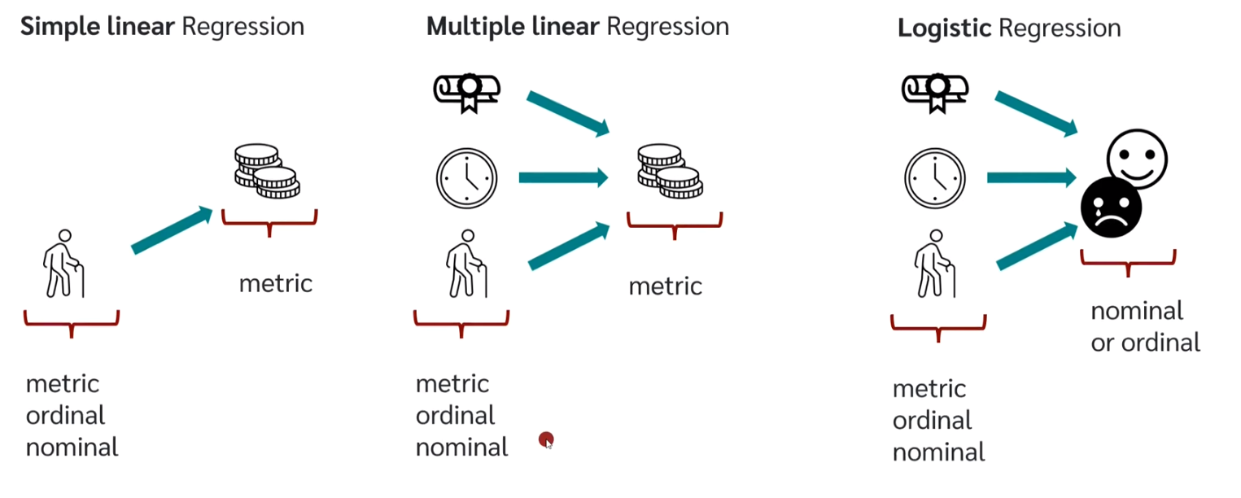
Level of Measurement

Slide 15

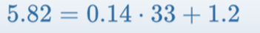
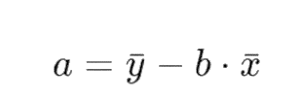
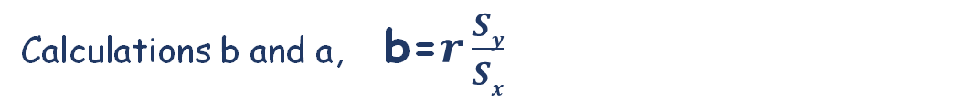
Simple Linear Regression
A general form or Standard Form Straight Line: y = mx + c
Calculations b and a, b=$r\frac{Sy}{Sx}$

Slide 16
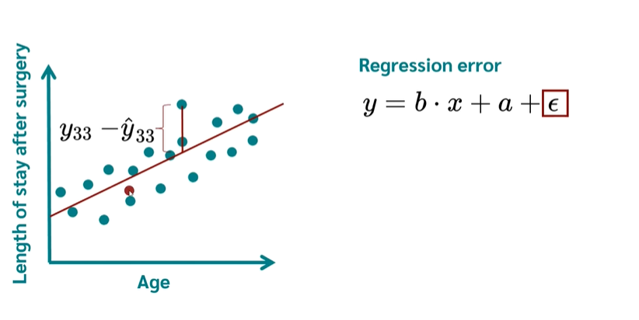
Simple Linear Regression

Slide 17
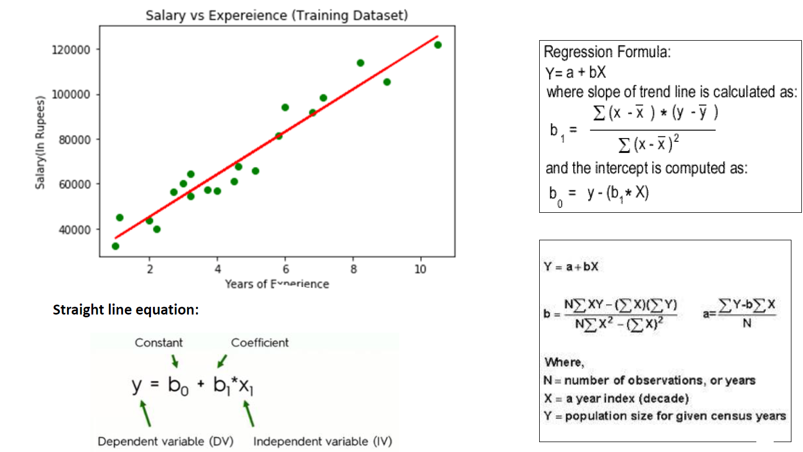
Simple Linear Regression
Years of experience

Slide 18
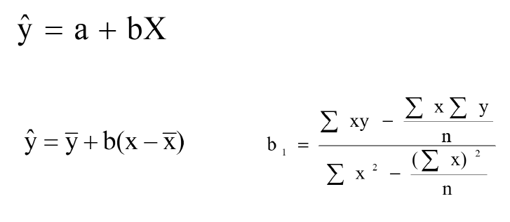
Best fit line calculation
By using the least-squares method(a procedure that minimizes the vertical deviations of plotted points surrounding a straight line)we are able to construct a best-fitting straight line to the scatter diagram points and then formulate a regression equation in the form of:

Slide 19
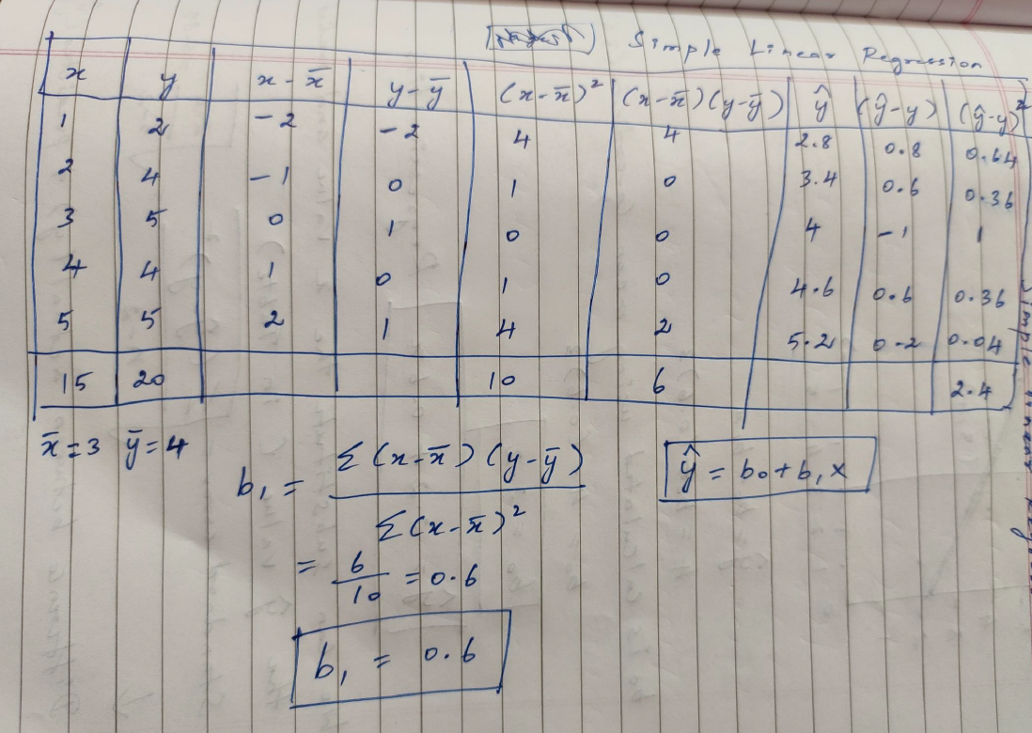

Slide 20
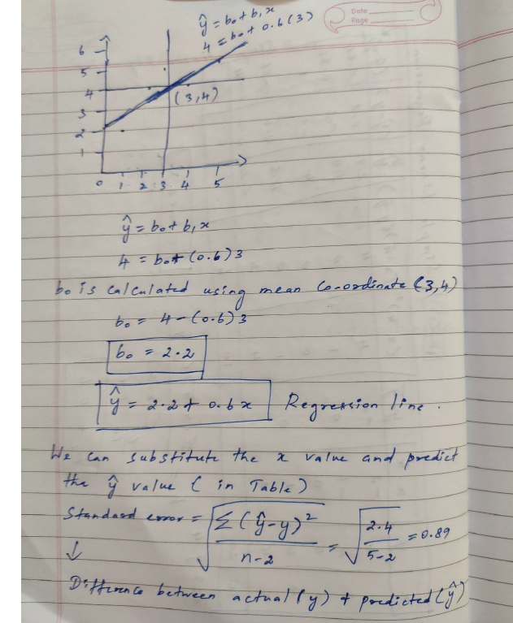

Slide 21
